Slide 1

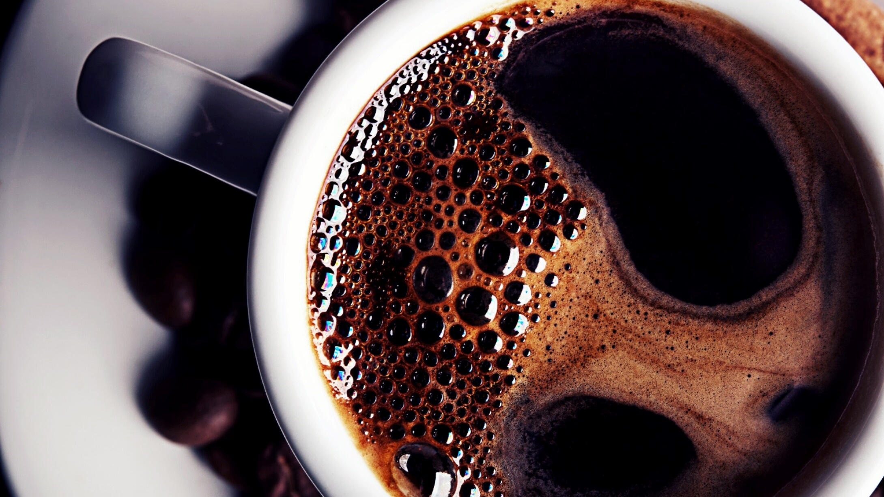
Coffee Shop Sales Report
Transaction records for Maven Roaster, a fictitious coffee shop
Operating out of three NYC location.

Slide 2
Introduction
The main objective of this project is to analyse retail sales data to gain actionable insights that will enhance the performance of the Coffee Shop

Slide 3
Problem Statement
How do sales vary by day of the week and hour of the day?
Are there any peak times for sales activity?
What is the total sales revenue for each month?
How do sales vary across different store locations?
what is the average price/order per person
Which products are the bestselling in terms of quantity and revenue?
How do sales vary by product category and type?

Slide 4
Analysis
Sales by Day of the Week:
Highest sales are observed on Thursday (4549 transactions) and Wednesday (4369 transactions).
The lowest sales occur on Sunday (1204 transactions).
Total Sales Revenue for April:
The total sales revenue for the month of April is $118,941.08.
Sales by Store Location:
Astoria: 8556 transactions.
Hell's Kitchen: 8629 transactions.
Lower Manhattan: 8150 transactions.
Hell's Kitchen has the highest number of transactions.

Slide 5
Analysis
Average Order Value:
The average bill per transaction is calculated as $4.69.
The average order per person is 1.44.
Best-Selling Products:
By revenue:
Coffee: $45,971.20
Tea: $33,356.95
By product type:
Barista Espresso: $15,555.90
Brewed Chai tea: $13,291.95

Slide 6
Analysis
Sales by Product Category:
Highest sales are from the Coffee category: $45,971.20.
Followed by Tea: $33,356.95.

Slide 7
Recommendations for Analysis
Focus marketing efforts on peak days, especially Thursday and Wednesday, to maximize sales.
Hell's Kitchen shows the highest transaction volume, indicating a strong customer base. Consider expanding services or promotions in this area.
Coffee and Tea categories are the top performers. Introduce new varieties or promotions to further boost sales in these categories.
This analysis can help you optimize operations, focus marketing strategies, and improve overall sales performance at the coffee shop.

